Slide 1
Style Transfer For Real-Time Videos & Images Using CNN
Project Guide: Presented By,
Ms. Joice t Ancy k j
Roll No:20

Slide 2
Relevance of the topic
Style transfer allows us to recompose the content of an image and also videos in the style of another.
If you've ever imagined what a photo or video might look like if it were painted by a famous artist, then style transfer that turns this into a reality.
This new capability opens up endless doors in design, content generation, the development of creativity tools, data augmentation etc.
It also helps in Photo and video editors, Artist-Community engagement, Commercial art, Gaming, Virtual Reality.

Slide 3
Description of the project
Style transfer is basically an algorithm which uses CNN to learn features from different images .
Then it mixes them together in a new image or real time video which is basically a combination of the two inputs.
We can style images, videos and real time videos which capture using camera.

Slide 4
Objective of the study
The objective of this project is to recompose the content of an image or video in the style of another image .
Transfer artistic style from one painting to another picture or real time video using convolutional neural network.
It gives an artistic touch to your image and video by using the style configurations of the other image.

Slide 5
Existing system Vs Proposed system
Existing system
A major limiting factor for previous approaches is that it can transform only images.
Proposed system
Here we can style images , videos as well as real time videos.
We can apply different styles in that.

Slide 6
Input and Output
Input
Content image or content video
Style
Output
output image or video with original content of the input and with the style of the style image.

Slide 7
Image Style Transfer
A Neural Algorithm of Artistic Style that can separate and recombine the image content and style of natural images.
The algorithm allows us to produce new images of high perceptual quality that combine the content of an arbitrary photograph with the appearance of numerous well known artworks.
Video Style Transfer
video is nothing but a collection of a set of images. These images are called frames and can be combined to get the original video.
Each frame is stylized using style image . we can loop through the steps for all individual frames, recombine and generate the stylized video.

Slide 8
Description of the Methodology
Steps to perform style transfer:
Give content images.
For videos extract frames.
Find content loss.
Find style loss.
Apply style by optimizing the loss.

Slide 9
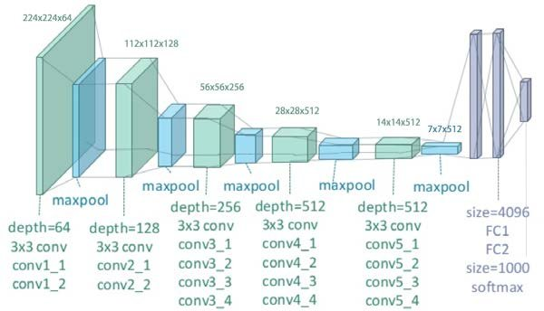
VGG19
VGG19 is composed by 16 convolutional layers (with 5 pooling layers) and 3 fully-connected layers . You can load a pretrained version of the network trained on more than a million images from the ImageNet database .

Slide 10
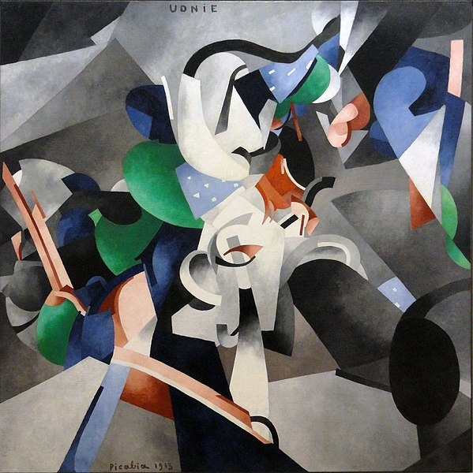
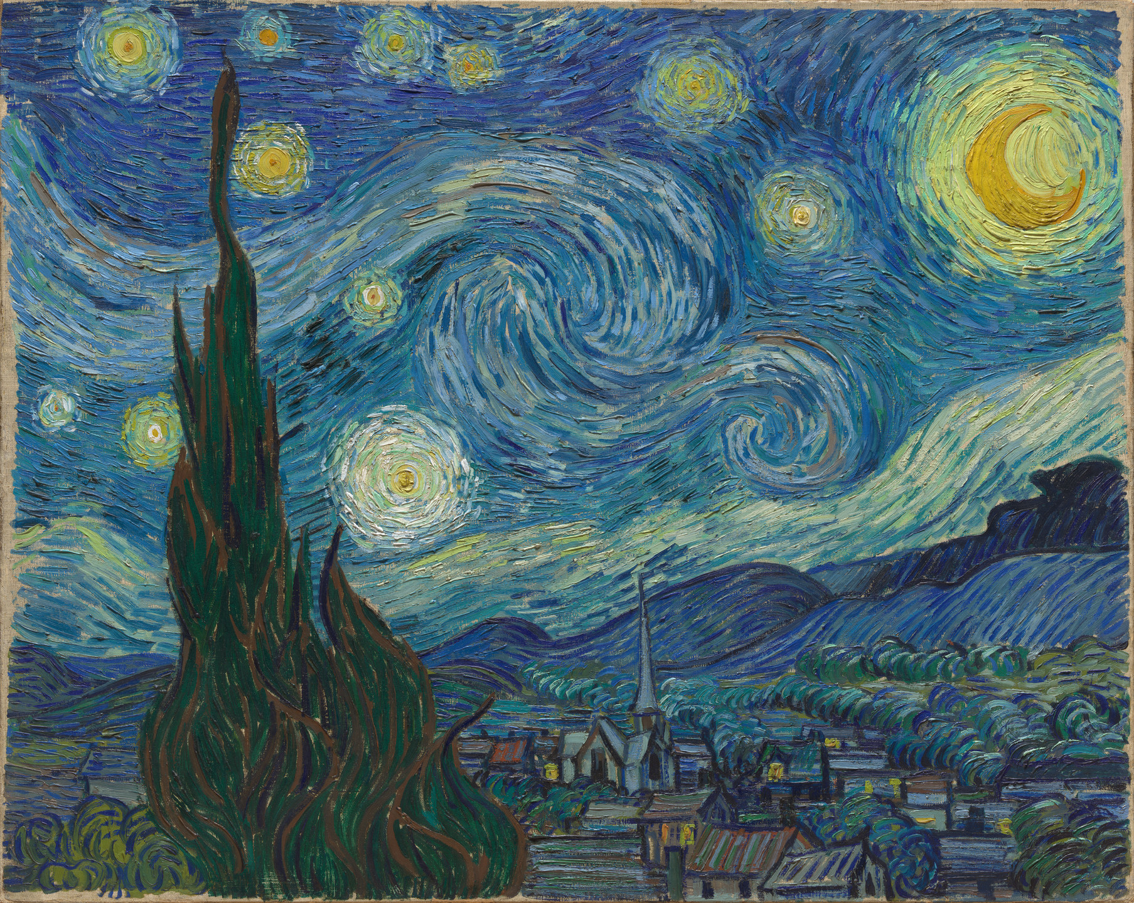
STYLES USED
UDNIE
STARRY NIGHTS

Slide 11
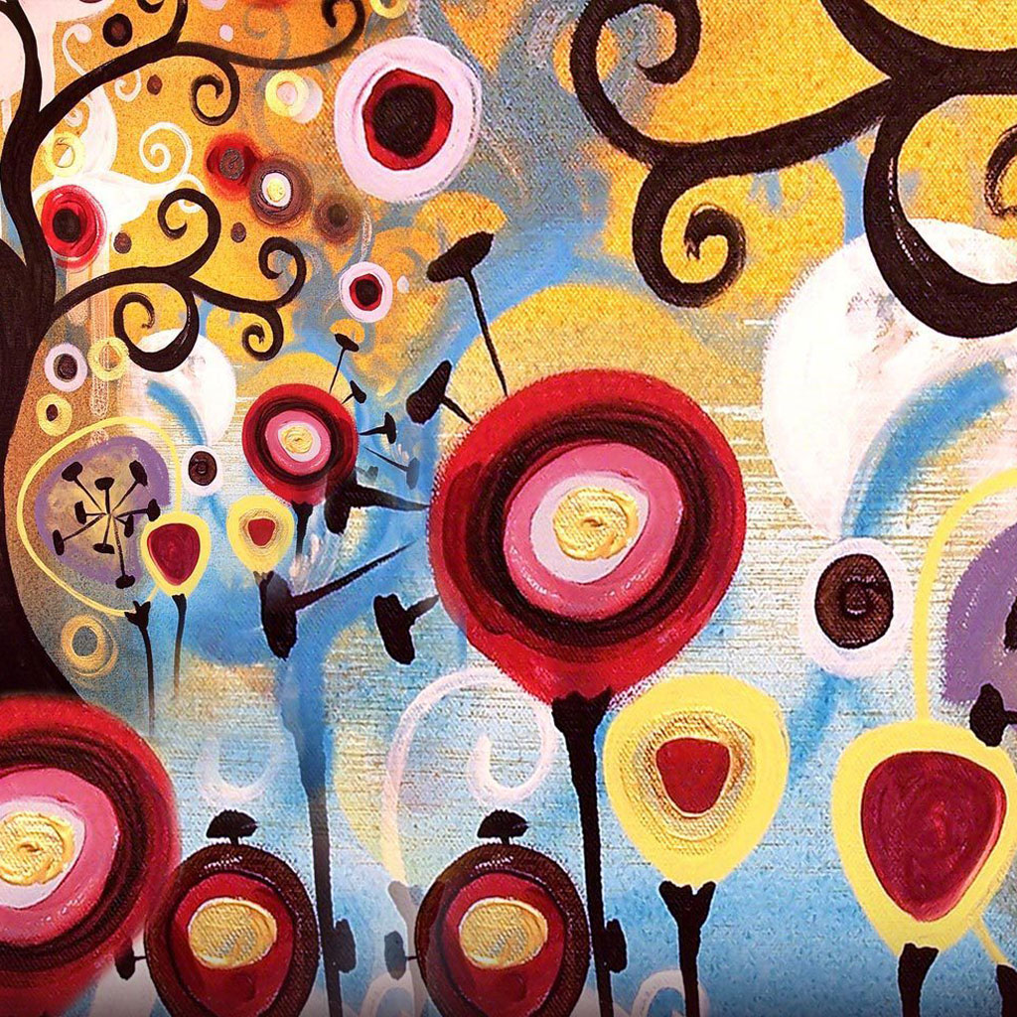
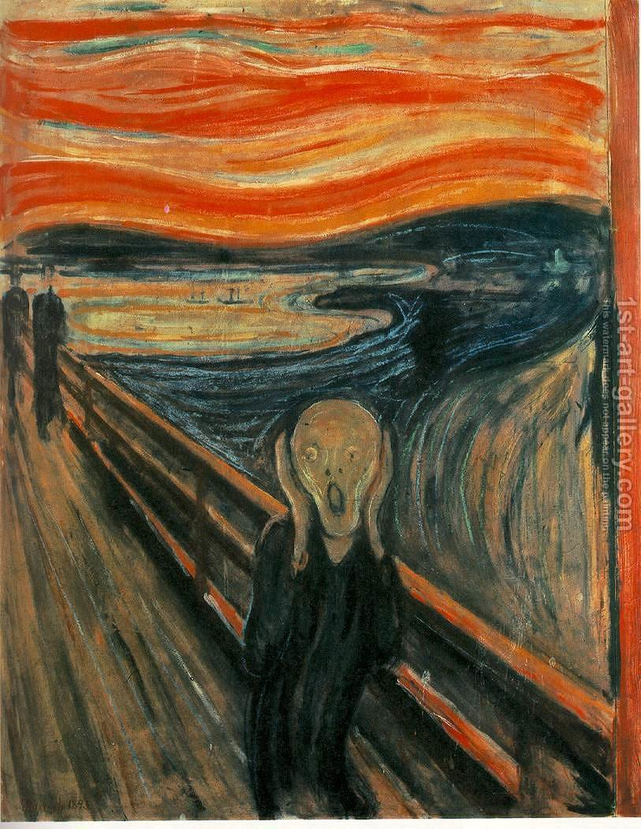
CANDY
SCREAM

Slide 12
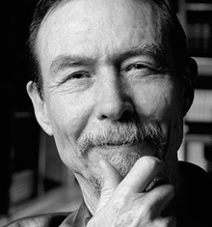
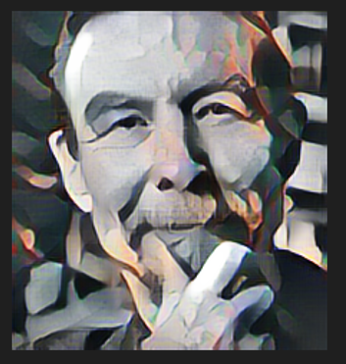
SCREENSH0TS

Slide 13
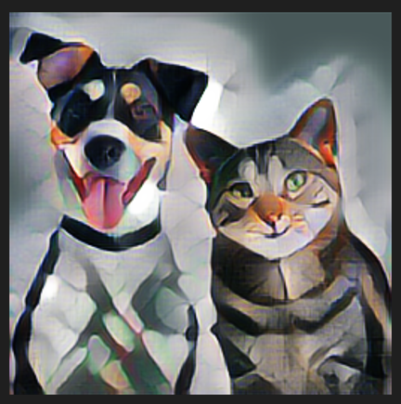
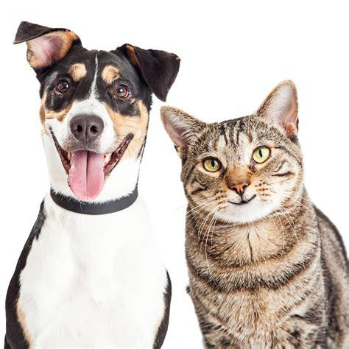

Slide 14
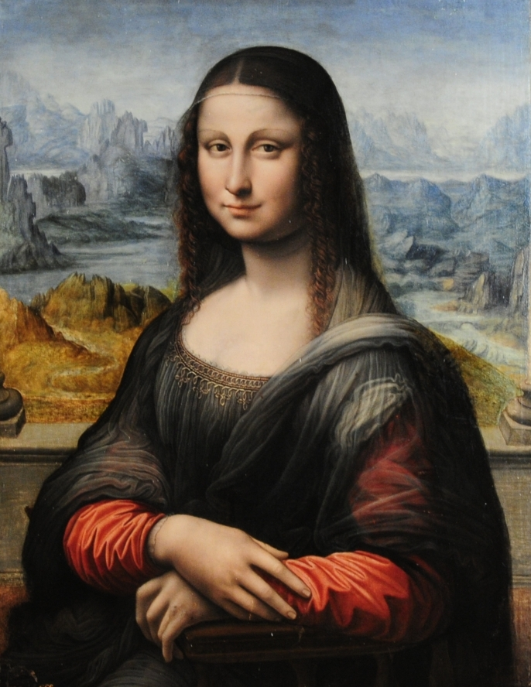
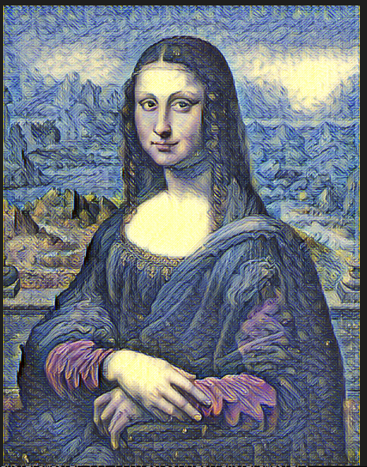

Slide 15
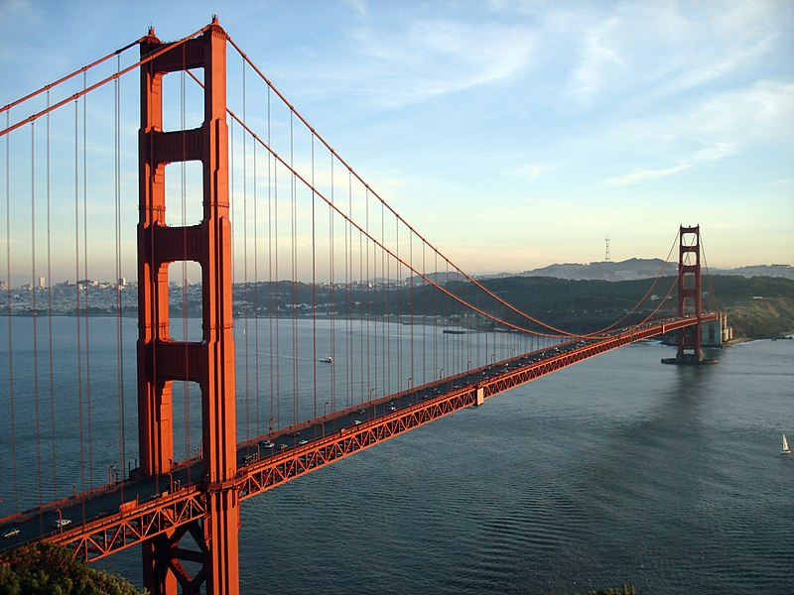
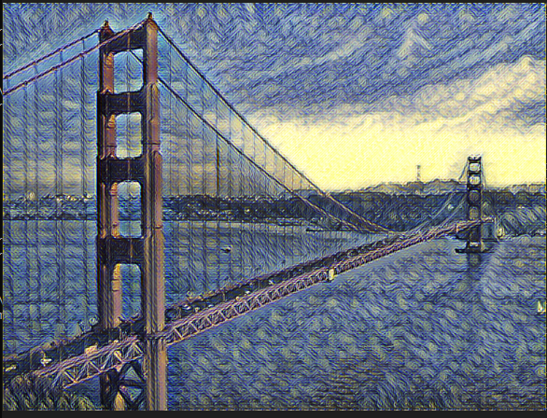

Slide 16
Thank you

